Slide 1
Food Safety: A Winnable Battle
U.S. Department of Health and Human Services
Centers for Disease Control and Prevention

Slide 2
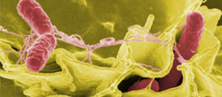
Foodborne illness in the U.S.
Each year, an estimated 1 in 6 Americans gets sick and 3,000 die of foodborne illness
Reducing foodborne illness by just ten percent would keep 5 million people from getting sick each year
Salmonella infections result in more hospitalizations and deaths than any other bacteria found in food and incurs $365 million in direct medical costs annually
“Food poisoning is always a miserable experience, but for the most vulnerable people, food safety can literally be a matter of life and death.” ~ Barbara Mahon, MD, MPH Deputy Chief, Enteric Diseases Epidemiology Branch, CDC

Slide 3
Any type of food can spread illness!
Graph shows the percentage of illnesses associated with 915 outbreaks of single food commodities from 2008-2012.
“Other” includes Crustacean , Fungus, Game, Oil-Sugar, and Root Vegetable
Data from CDC’s National Outbreak Reporting System, 2008-2012
Notes:
Shows the breakdown of causes of illness by type with the largest number caused by fruits-nuts, poultry, vine (tomatoes, cucumbers) beef, eggs, leafy greens, pork, grains-beans, fish, mollusk, sprout and other.

Slide 4
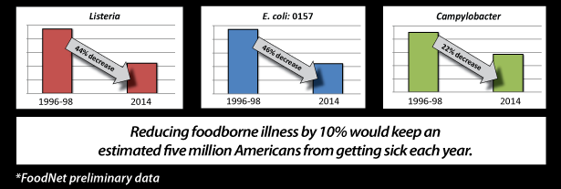
Data show progress but more work is needed to decrease foodborne infections
Healthy People 2020 targets reduction in illnesses caused by foodborne bacteria including Listeria, E. coli
and Campylobacter

Slide 5
“There are certain things only a government can do … one is ensuring that the foods we eat are safe and do not cause us harm. “ ~ President Barack Obama
Nonregulatory
Regulatory
CDC
Surveillance
Outbreak detection and investigation
Analysis of burden, trends, and effectiveness of prevention efforts and policy change
Attribution to sources
Education and training
Information for policy
FDA and USDA
Inspection
Enforcement
Outbreak investigation
Product recall
Product traceback
Education and training
Risk assessment and management
Source assessment

Slide 6
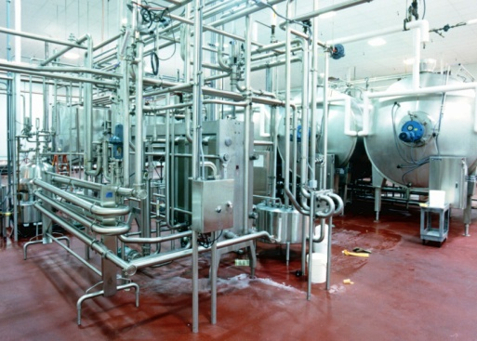
Providing the vital link
CDC provides the vital link between illness in people and the food safety policies and practices of government agencies, food producers, and retail food establishments

Slide 7
CDC Winnable Battle work supports the Food Safety Modernization Act
Support strong partnerships with federal, state, and local public health agencies
Promote laboratory, epidemiologic, and environmental health networks
Strengthen systems and agreements for surveillance and data exchange
Improve communications with the public health community, industry, and consumers
Provide international expertise in foodborne illness
“We need to ensure that all Americans have access to foods
that are both healthy and safe.” ~ Thomas Frieden, MD, MPH, CDC Director and ATSDR Administrator

Slide 8
CDC Winnable Battle work supports Healthy People 2020
Reduce infections caused by key foodborne germs
Reduce outbreak-associated infections associated with food categories
Prevent increases in antimicrobial resistance
Increase the number of consumers who follow key food safety practices

Slide 9
CDC uses multiple strategies to increase food safety
Detect and investigate outbreaks to stop the spread and learn how to prevent the next one
Build investigative public health capacity at the state and local level by applying best practices
Work with partners (public health, industry, consumer groups, etc.) to share food safety data and information to improve practices
Stop the spread of antibiotic resistant bacteria
Drive policy and prevention with data and analyses
Notes:
Lots of players involved in keeping America’s food supply safe. Each participant in the food safety system—farmers, industry, regulators,

Slide 10
CDC Food Safety priorities
Monitor foodborne disease trends through robust surveillance systems
Determine attribution of illness to specific foods
Apply innovative technologies (Advanced Molecular Detection) and address challenges of Culture Independent Diagnostic Testing (CIDT)
Report environmental factors related to foodborne illness outbreaks
Strengthen federal, state, local, and industry policies and practices for food preparation and handling

Slide 11
Food Safety Progress: Discovery
Increasing number of multistate foodborne disease outbreaks, 1993–2012
Multistate outbreaks are detected more frequently
Each year, >150 national or multistate and >1,000 state and local investigations
Since 2006, 22 newly recognized food vehicles that can transmit pathogens
Data from CDC’s Foodborne Disease Outbreak Surveillance System

Slide 12
Food Safety Progress: Discovery
22 new foods identified in U.S. multistate outbreaks since 2006
Bagged spinach
Carrot juice
Peanut butter
Broccoli powder on a snack food
Dog food
Pot pies/frozen meals
Canned hot dog chili sauce
Fresh hot chili peppers
Black pepper
Tahini sesame paste
Raw cookie dough
Par-cooked, broiled chicken livers
Scraped tuna
Cashew cheese
Cucumbers
Sugar cane juice
Chia powder
Fresh papaya
Frozen mamay fruit pulp
Bologna
In-shell hazelnuts
Pine nuts
Data from: PulseNet, OutbreakNet, and Foodborne Disease Outbreak Surveillance System
Notes:
12

Slide 13
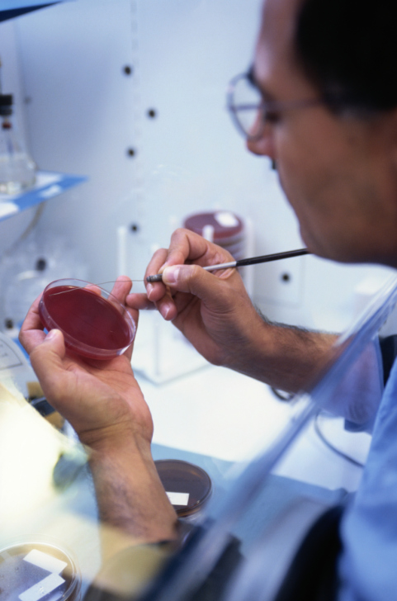
Food Safety Progress: Innovation
Applying Technologies
Faster processing and reporting of multiple sources of information during an outbreak by state and local partners
Quicker methods to identify, characterize, and fingerprint Salmonella and other food-related pathogens in public health laboratories
Integration of foodborne illness surveillance systems and expanded data sharing as called for in the Food Safety Modernization Act
Notes:
This slide’s title, “Take action” seems vague

Slide 14
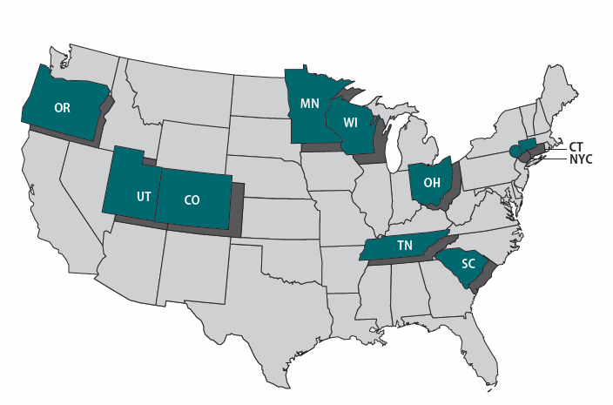
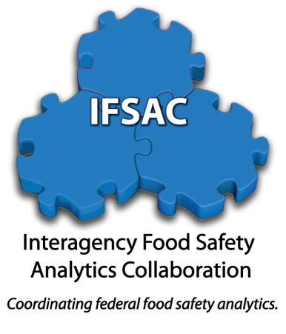
Food Safety Progress: Innovation
Improving Processes
FoodCORE sites use student teams in state and local health departments to interview patients rapidly and solve outbreaks faster
Interagency Food Safety Analytics Collaboration (IFSAC) is an initiative across three federal agencies to attribute foodborne illnesses to specific food categories using surveillance data
Integrated Food Safety Centers of Excellence make new trainings in outbreak investigations available to all states.

Slide 15
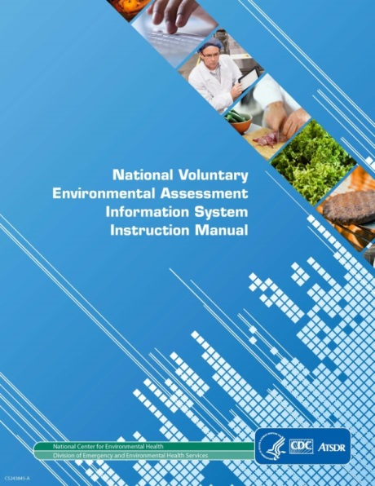
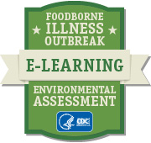
Food Safety Progress: Implementation
National Voluntary Environmental Assessment Information System (NVEAIS)
Facilitates discovery of environmental factors that cause foodborne outbreaks to prevent next one
e-Learning on Environmental Assessment of Foodborne Illness Outbreaks
Improves competency in collecting environmental factor data during foodborne outbreak investigations
http://www.cdc.gov/nceh/ehs/NVEAIS/index.htm; http://www.cdc.gov/nceh/ehs/elearn/ea_fio/
Notes:
CDC developed and launched two tools to address the gap in capturing environmental factor data and help state and local food programs identify and address gaps so they can better prevent future outbreaks:
The National Voluntary Environmental Assessment Information System and
An innovative e-Learning course.

Slide 16
Food Safety Progress: Implementation
Strengthen policies and practices in three areas:
Preventing restaurant workers from working when sick
Food handling by a sick worker is a contributing factor in 46% of restaurant-related outbreaks.
Improving handwashing practices and minimize bare-hand contact with food
Bare-hand contact by a food worker is a contributing factor in 29% of restaurant-related outbreaks
Requiring trained, certified kitchen managers to be present during all hours of operation
Restaurants with certified managers are less likely to be linked with outbreaks.
http://www.cdc.gov/nceh/ehs/ehsnet/foodborne_illness_outbreaks.htm
Notes:
CDC’s second environmental health food safety priority is to strengthen policies and practices in three areas:
[read slide bullets]

Slide 17
Food Safety Progress: Implementation
Expanding and improving national surveillance for foodborne illness with state and federal partners
Developing new approaches for sharing data using electronic networks
Supporting and enhancing PulseNet capacity at state and national levels
Defining and disseminating best public health practices to promote
adoption in all 50 states
Updating and improving national
guidelines for foodborne outbreak
response (CIFOR)

Slide 18
Food Safety Progress: Collaborating with partners
Disseminating data from CDC restaurant food safety studies
Influencing federal, state, and local policy changes through participation in federal and partner work groups
Influencing industry changes by sharing study findings with industry associations and food service industry leaders
Focusing state and local funding on food safety
http://www.cdc.gov/nceh/ehs/ehsnet/foodsafety.htm
Notes:
CDC is taking action to address this environmental health food safety priority by [read slide]

Slide 19
Food Safety Progress: Collaborating with partners
Tracking number of states with policies that promote:
Improved ill worker policies,
Improved hand hygiene policies, and
Certified kitchen managers.
Using NVEAIS to track number of outbreaks caused by problems with ill workers, hand hygiene, and lack of certified kitchen managers
Notes:
CDC is measuring progress in to addressing this environmental health food safety priority by [read slide]

Slide 20
More work needs to be done.
Working together will lead to success.
Notes:
Percentage Change in 2012 compared to 2006-2008: Campylobacter-13% increase, E. coli O157-no change, Listeria-no change, Salmonella-no change, Vibrio-75% increase, Yersinia-no change
2013 rate per 100,000 Population: Campylobacter-13.82, E. coli O157-1.15, Listeria-0.26, Salmonella-15.19, Vibrio-0.51, Yersinia-0.36
2020 target rate per 100,000 Population: Campylobacter-8.5, E. coli O157-0.6, Listeria-0.2, Salmonella-11.4, Vibrio-0.2, Yersinia-0.3

Slide 21
Thank you
U.S. Department of Health and Human Services
Centers for Disease Control and Prevention

