Slide 1


Child & Family Wellbeing Indicators Report
State Trends and a County by County Ranking on 18 Indicators of Child and Family Wellbeing
Presented by Jared R. Anderson, PhD
Sharon L. Deitz, MS
Kansas State University
Based on 2015 Report
Presented on June 25, 2015
Notes:
June 25-26 in Pittsburg (includes Crawford, Bourbon, Labette, Montgomery) Wilkinson Alumni Center at Pittsburg State University 401 E Ford Ave. Pittsburg

Slide 2
PURPOSE
Overview of state-level trends and a county by county comparison on indicators of child and family wellbeing.
Aid government officials, policymakers, community leaders, faith organizations, helping professionals, and Kansas citizens understand the state of child and family wellbeing in their local area.
Assist in helping local communities target specific areas for improving the health of children and families.

Slide 3
INDICATORS OF CHILD
WELL-BEING
Child poverty
Childcare Assistance
Divorce
Free & Reduced Lunch
High school Dropout
Infant Mortality
Lack of Maternal Education
Low Birth Weight Babies
Medicaid
Nonmarital Births
Parental Unemployment
Single Parent Households
SNAP
TANF
Teen Pregnancy
Uninsured Children
Youth Binge Drinking
Youth Tobacco Use

Slide 4

WHY THESE 18?
Based on current literature, and DCF input, on factors associated with child and family wellbeing outcomes.
Measured at the state and county level on an annual basis.
Measurement remains consistent each year.
Interpretable rate allows for observation of change from year to year.

Slide 5
County spotlights

Slide 6
Bourbon
 | Bourbon | Kansas
2013 Population | 14,826 | 2,895,801
2010 Persons per sq. mile | 23.9 | 34.9
2009- 2013 Median household income | $39,591 | $51,332
Rank: 103/105
Z-Score: 0.90

Slide 7
Crawford
 | Crawford | Kansas
2013 Population | 39,330 | 2,895,801
2010 Persons per sq. mile | 66.4 | 34.9
2009- 2013 Median household income | $37,378 | $51,332
Rank: 85/105
Z-Score: 0.47
Notes:
June 25-26 in Pittsburg (includes Crawford, Bourbon, Montgomery) Wilkinson Alumni Center at Pittsburg State University 401 E Ford Ave. Pittsburg

Slide 8
Labette
 | Labette | Kansas
2013 Population | 20,969 | 2,895,801
2010 Persons per sq. mile | 33.5 | 34.9
2009- 2013 Median household income | $40,916 | $51,332
Rank: 102/105
Z-Score: 0.85
Notes:
June 25-26 in Pittsburg (includes Crawford, Bourbon, Montgomery) Wilkinson Alumni Center at Pittsburg State University 401 E Ford Ave. Pittsburg

Slide 9
Montgomery
 | Montgomery | Kansas
2013 Population | 34,396 | 2,895,801
2010 Persons per sq. mile | 55.1 | 34.9
2009- 2013 Median household income | $39,669 | $51,332
Rank: 101/105
Z-Score: 0.82

Slide 10
Ranking by Indicator
 | Bourbon | Crawford | Labette | Montgomery
COMPOSITE RANK | 103 | 85 | 102 | 101
Child poverty | 104 | 95 | 100 | 95
Childcare | 99 | 74 | 102 | 92
Divorce | 87 | 64 | 53 | 98
Free & reduced lunch | 98 | 78 | 91 | 87
HS Dropout | 88 | 36 | 68 | 88
Infant Mortality | 38 | 45 | 75 | 37
Low birth weight babies | 15 | 59 | 81 | 65
Medicaid | 101 | 96 | 99 | 102
Mothers without a HS Diploma | 61 | 51 | 88 | 80
Nonmarital births | 80 | 91 | 99 | 102
Parental unemployment | 77 | 98 | 49 | 59
Single parent households | 73 | 50 | 89 | 90
SNAP | 104 | 101 | 98 | 102
TANF | 101 | 75 | 100 | 96
Teen pregnancy | 98 | 61 | 80 | 94
Uninsured children | 21 | 39 | 24 | 46
Youth binge drinking | 78 | 69 | 88 | 60
Youth tobacco use | 98 | 78 | 82 | 86

Slide 11
Compared to each other…
#57
#101
#85
#102
#103

Slide 12
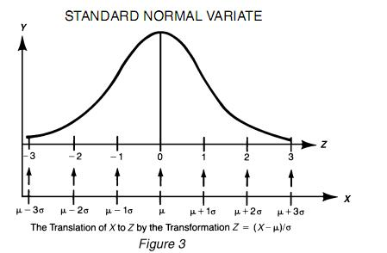
INTERPETING Z-SCORES
When everything is measured with one unit, we can interpret what each score means in comparison to one another.
  0 = average/mean
  Negative value = below the mean
  Positive value = above the mean
  Because our indicators are negative indicators of child and family wellbeing, higher/positive scores are worse.
  The likelihood of a value below -1 and above 1 is slight. Meaning if an indicator has a score of -1.32, they are doing very well, but a score of 1.32 means they are doing poorly.
Good
Bad

Slide 13
RANKINGS
A high overall ranking does not mean that a given county ranks highly on each individual indicator.
There are other indicators that could also serve as targets for intervention not included in this report (e.g., literacy, parenting skills, father involvement, skilled job training, money management) that could have an impact on child poverty locally.
Need to be aware of trends in intervention target to determine whether the community intervention made a difference.
  Example: Teen Pregnancy
Need for local evaluation of intervention targets.

Slide 14
Child poverty
Based on the Child Poverty Report: Fact Sheet of Factors Associated with Child Poverty (Anderson et al., 2014)

Slide 15
Child Poverty
CHILD POVERTY IS A SYSTEMIC SOCIETAL CANCER THAT THREATENS THE PRESENT AND FUTURE WELL-BEING OF CHILDREN. ALTHOUGH A MULTITUDE OF FACTORS PLAY A ROLE IN WHETHER CHILDREN WILL GROW UP IN POVERTY, EDUCATION, EMPLOYMENT, AND FAMILY STRUCTURE HAVE CONSISTENTLY BEEN LINKED TO SUBSEQUENT POVERTY

Slide 16
Education
Education is a major protective factor against child poverty.
  When heads of households have at least a high school diploma, they earn nearly $22,000 more a year compared to those who dropped out of high school.²
  The difference between earning a high school diploma and a bachelor’s degree is even more remarkable as heads of households with a bachelor’s degree earn nearly $55,000 more than those with a high school diploma.²

Slide 17
Education
Nearly half of Kansas children in poverty have parents who do not have a high school diploma.³
Educated parents are likely to have more developed skills for the labor market, which result in higher levels of employment and higher earnings when employed.⁴
Improving education and enhancing opportunities for advanced training and education is a key variable in the fight against child poverty.

Slide 18
Education
High School Dropout
Mothers without a High School Diploma
Washington
Marshall
Nemaha
Brown
Doniphan
Cheyenne
Rawlins
Decatur
Norton
Phillips
Smith
Jewell
Republic
Jackson
Atchison
Sherman
Sheridan
Graham
Osborne
Mitchell
Cloud
Clay
Riley
Pottawatomie
Leavenworth
Thomas
Rooks
Jefferson
Wyandotte
Lincoln
Ottawa
Shawnee
Wallace
Logan
Gove
Trego
Ellis
Russell
Dickinson
Geary
Wabaunsee
Douglas
Johnson
Ellsworth
Saline
Morris
Osage
Franklin
Miami
Greeley
Wichita
Scott
Lane
Ness
Rush
Barton
McPherson
Lyon
Rice
Marion
Chase
Coffey
Anderson
Linn
Finney
Hodgeman
Pawnee
Kearny
Stafford
Reno
Harvey
Woodson
Allen
Bourbon
Hamilton
Edwards
Butler
Greenwood
Gray
Ford
Pratt
Kingman
Sedgwick
Wilson
Neosho
Crawford
Stanton
Grant
Haskell
Kiowa
Elk
Sumner
Cowley
Labette
Cherokee
Morton
Stevens
Seward
Meade
Clark
Comanche
Barber
Harper
Chautauqua
Montgomery
1-25
51-75
101-105
26-50
76-100

Slide 19
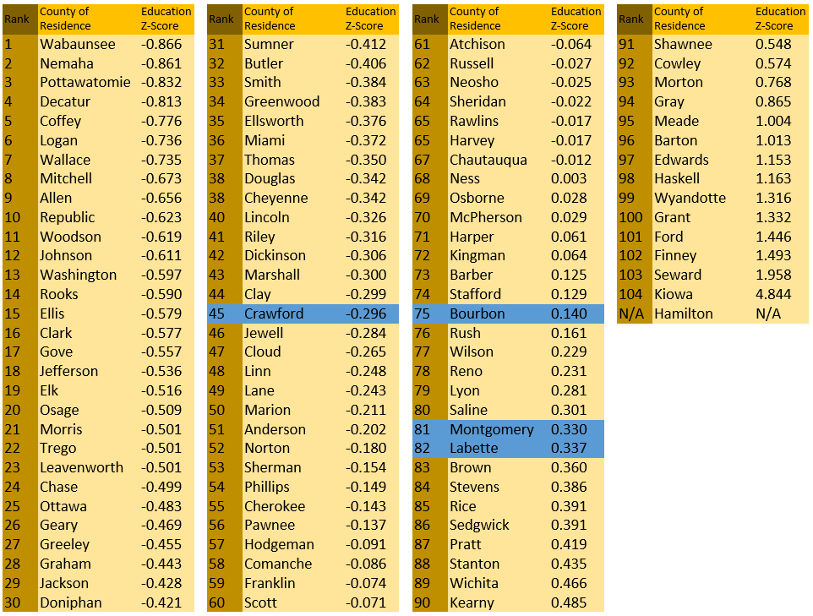

Slide 20
Employment
The unemployment rate is a strong and reliable predictor of child poverty; when states have increases in unemployment, child poverty rates tend to increase.⁵
66% of children who are living in poverty in Kansas have parents who are unemployed or underemployed (i.e., working part-time or part-year).⁶
  A reduced demand for less-skilled workers, however, means that it is difficult for many poor parents to find long-term, full-time job opportunities.⁷

Slide 21
Employment
Parents who are working but still poor are likely to be employed in jobs that exacerbate parental stress.
  Many of these parents have unstable and nonstandard work schedules; moreover, about 40% of low-income parents have no paid time off (sick days, medical leave, etc.).⁸
Increasing employment, therefore, is a key factor in reducing child poverty, but not all jobs are enough to lift families out of poverty.

Slide 22
Economic Factors
Child Poverty
Parental Unemployment
Uninsured Children
Washington
Marshall
Nemaha
Brown
Doniphan
Cheyenne
Rawlins
Decatur
Norton
Phillips
Smith
Jewell
Republic
Jackson
Atchison
Sherman
Sheridan
Graham
Osborne
Mitchell
Cloud
Clay
Riley
Pottawatomie
Leavenworth
Thomas
Rooks
Jefferson
Wyandotte
Lincoln
Ottawa
Shawnee
Wallace
Logan
Gove
Trego
Ellis
Russell
Dickinson
Geary
Wabaunsee
Douglas
Johnson
Ellsworth
Saline
Morris
Osage
Franklin
Miami
Greeley
Wichita
Scott
Lane
Ness
Rush
Barton
McPherson
Lyon
Rice
Marion
Chase
Coffey
Anderson
Linn
Finney
Hodgeman
Pawnee
Kearny
Stafford
Reno
Harvey
Woodson
Allen
Bourbon
Hamilton
Edwards
Butler
Greenwood
Gray
Ford
Pratt
Kingman
Sedgwick
Wilson
Neosho
Crawford
Stanton
Grant
Haskell
Kiowa
Elk
Sumner
Cowley
Labette
Cherokee
Morton
Stevens
Seward
Meade
Clark
Comanche
Barber
Harper
Chautauqua
Montgomery
1-25
51-75
101-105
26-50
76-100

Slide 23
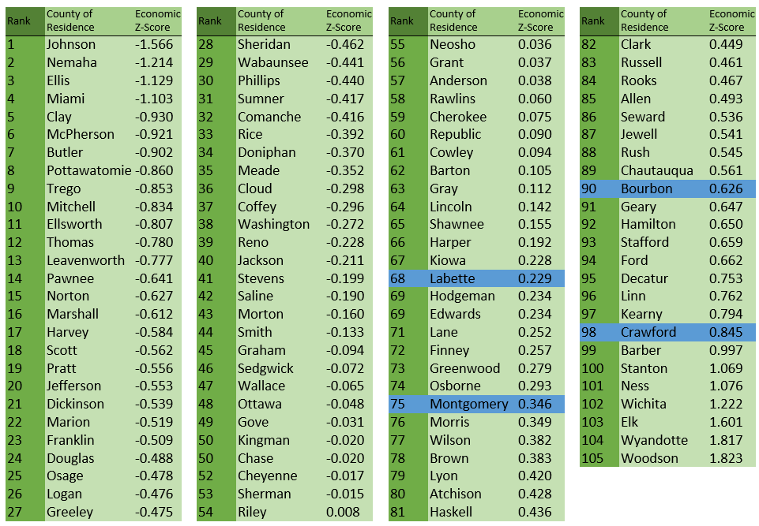

Slide 24
Family Structure
Children in married-couple families are far less likely to experience poverty than children in cohabiting or single parent homes; being raised in a married household reduces the risk of experiencing poverty by approximately 80%.⁹
Societal level changes, including high divorce rates, declining marriage rates, and continuously rising non-marital birth rates have increased the likelihood that children will live in poverty.¹⁰

Slide 25
Family Structure
Divorce
Nonmarital Births
Single Parent Households
Teen Pregnancy
Washington
Marshall
Nemaha
Brown
Doniphan
Cheyenne
Rawlins
Decatur
Norton
Phillips
Smith
Jewell
Republic
Jackson
Atchison
Sherman
Sheridan
Graham
Osborne
Mitchell
Cloud
Clay
Riley
Pottawatomie
Leavenworth
Thomas
Rooks
Jefferson
Wyandotte
Lincoln
Ottawa
Shawnee
Wallace
Logan
Gove
Trego
Ellis
Russell
Dickinson
Geary
Wabaunsee
Douglas
Johnson
Ellsworth
Saline
Morris
Osage
Franklin
Miami
Greeley
Wichita
Scott
Lane
Ness
Rush
Barton
McPherson
Lyon
Rice
Marion
Chase
Coffey
Anderson
Linn
Finney
Hodgeman
Pawnee
Kearny
Stafford
Reno
Harvey
Woodson
Allen
Bourbon
Hamilton
Edwards
Butler
Greenwood
Gray
Ford
Pratt
Kingman
Sedgwick
Wilson
Neosho
Crawford
Stanton
Grant
Haskell
Kiowa
Elk
Sumner
Cowley
Labette
Cherokee
Morton
Stevens
Seward
Meade
Clark
Comanche
Barber
Harper
Chautauqua
Montgomery
1-25
51-75
101-105
26-50
76-100

Slide 26
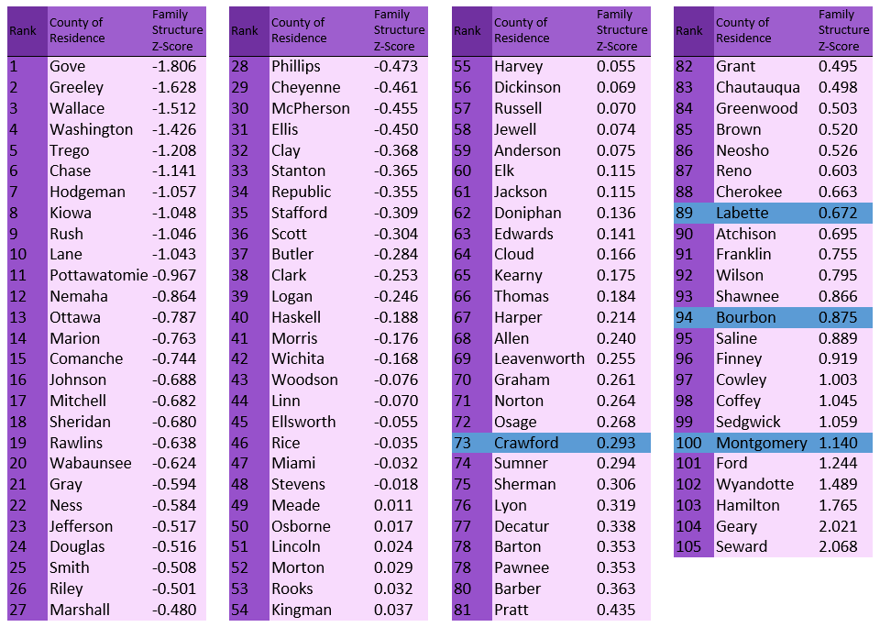

Slide 27
Linking the Three
Education, employment, and family structure are inextricably linked to each other.
  For example, graduating from high school is associated with more consistent employment later in life.¹¹
  The decline in work rates among males plays a role in marriage rates; that is, men with low work rates lack the economic stability that is conducive to family formation.¹²
Giving attention to the unique contribution of each factor, the interplay between factors, and taking into consideration racial and ethnic disparities within each factor may inform policies that can ultimately strengthen children’s economic position.

Slide 28
Other domains

Slide 29
Aid Programs
Childcare
Free & Reduced Lunch
Medicaid
SNAP
TANF
Washington
Marshall
Nemaha
Brown
Doniphan
Cheyenne
Rawlins
Decatur
Norton
Phillips
Smith
Jewell
Republic
Jackson
Atchison
Sherman
Sheridan
Graham
Osborne
Mitchell
Cloud
Clay
Riley
Pottawatomie
Leavenworth
Thomas
Rooks
Jefferson
Wyandotte
Lincoln
Ottawa
Shawnee
Wallace
Logan
Gove
Trego
Ellis
Russell
Dickinson
Geary
Wabaunsee
Douglas
Johnson
Ellsworth
Saline
Morris
Osage
Franklin
Miami
Greeley
Wichita
Scott
Lane
Ness
Rush
Barton
McPherson
Lyon
Rice
Marion
Chase
Coffey
Anderson
Linn
Finney
Hodgeman
Pawnee
Kearny
Stafford
Reno
Harvey
Woodson
Allen
Bourbon
Hamilton
Edwards
Butler
Greenwood
Gray
Ford
Pratt
Kingman
Sedgwick
Wilson
Neosho
Crawford
Stanton
Grant
Haskell
Kiowa
Elk
Sumner
Cowley
Labette
Cherokee
Morton
Stevens
Seward
Meade
Clark
Comanche
Barber
Harper
Chautauqua
Montgomery
1-25
51-75
101-105
26-50
76-100

Slide 30
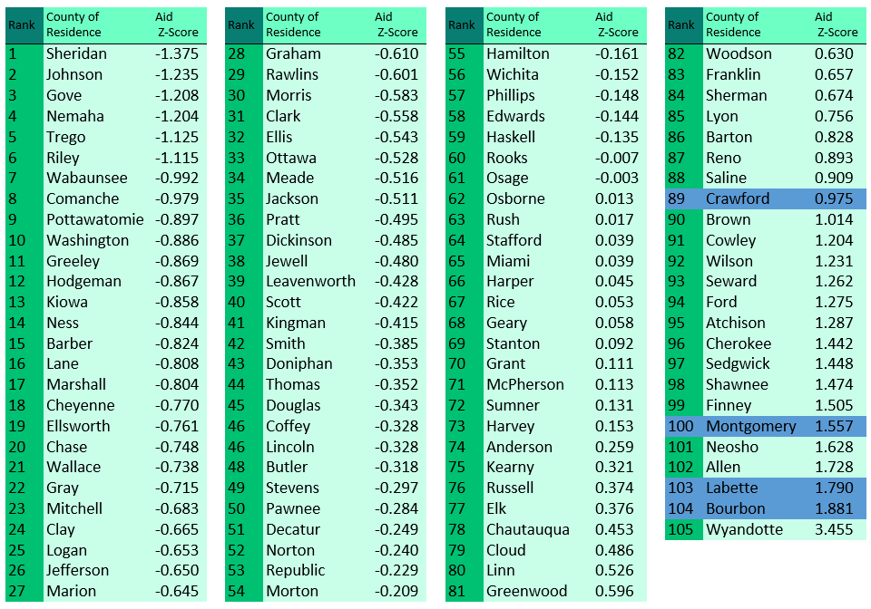

Slide 31
Health
Infant Mortality
Low Birth Weight Babies
Youth Binge Drinking
Youth Tobacco Use
Washington
Marshall
Nemaha
Brown
Doniphan
Cheyenne
Rawlins
Decatur
Norton
Phillips
Smith
Jewell
Republic
Jackson
Atchison
Sherman
Sheridan
Graham
Osborne
Mitchell
Cloud
Clay
Riley
Pottawatomie
Leavenworth
Thomas
Rooks
Jefferson
Wyandotte
Lincoln
Ottawa
Shawnee
Wallace
Logan
Gove
Trego
Ellis
Russell
Dickinson
Geary
Wabaunsee
Douglas
Johnson
Ellsworth
Saline
Morris
Osage
Franklin
Miami
Greeley
Wichita
Scott
Lane
Ness
Rush
Barton
McPherson
Lyon
Rice
Marion
Chase
Coffey
Anderson
Linn
Finney
Hodgeman
Pawnee
Kearny
Stafford
Reno
Harvey
Woodson
Allen
Bourbon
Hamilton
Edwards
Butler
Greenwood
Gray
Ford
Pratt
Kingman
Sedgwick
Wilson
Neosho
Crawford
Stanton
Grant
Haskell
Kiowa
Elk
Sumner
Cowley
Labette
Cherokee
Morton
Stevens
Seward
Meade
Clark
Comanche
Barber
Harper
Chautauqua
Montgomery
1-25
51-75
101-105
26-50
76-100

Slide 32
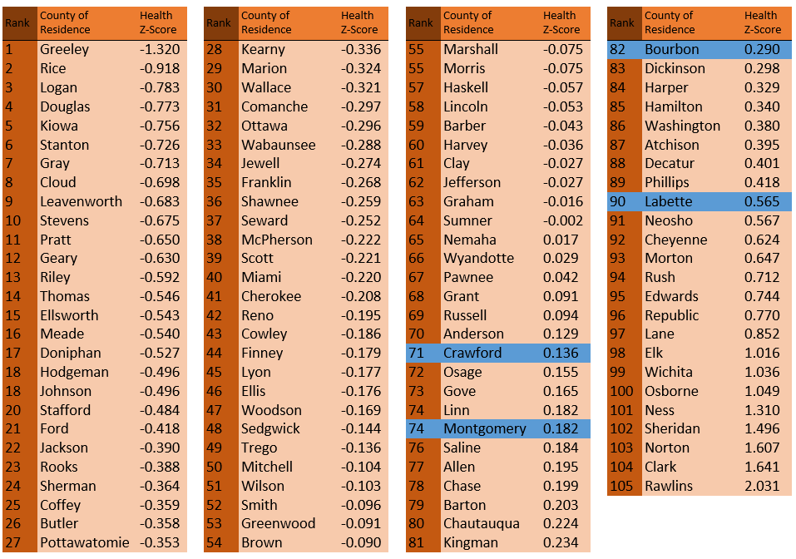

Slide 33
Child poverty

Slide 34
Child Poverty
The estimated percent of children under the age of 18 living in families with incomes below 100% of the U.S. poverty threshold.

Slide 35
Childcare Assistance

Slide 36
Child Care Assistance
The average number of individuals per month receiving Child Care benefits out of the total population.

Slide 37
Divorce

Slide 38
Divorce
The total number of divorces and annulments out of total population times 1000.

Slide 39
Free & Reduced Lunch

Slide 40
Free & Reduced Lunch Program Enrollment
Enrollment represents school total headcount enrollment as of September 20th of each year

Slide 41
High school dropout

Slide 42
High School Dropout
Yearly total dropouts divided by the total enrollment of grades 7-12. Dropouts are not synonymous with “not graduating.” Year reported refers to year in which the school year began; for 2012, this refers to the 2012-2013 academic year.

Slide 43
Infant mortality

Slide 44
Infant Mortality
The death of a live-born infant that occurs within the first year of life. Rate is calculated by the number of infant deaths divided by the number of live births times 1000.

Slide 45
Low Birth weight babies

Slide 46
Low Birthweight Babies
The percentage of live births weighing less than 5.5 pounds out of total live births.

Slide 47
Medicaid enrollment

Slide 48
Medicaid Enrollment
The unique (unduplicated) number of individuals that received Medicaid benefits out of the total population.

Slide 49
Mothers without a
High school diploma

Slide 50
Mothers without a
High school diploma
The percentage of live births to mothers who have not received a high school degree, as indicated on the child’s birth certificate out of total live births.

Slide 51
Nonmarital births

Slide 52
Nonmarital Births
A birth occurring to a mother who is not married at the time of conception or at the time of the birth or any time between conception and birth. Calculated rate by taking the total number of nonmarital births divided by total live births times 100.

Slide 53
Parental unemployment
Percentage of families where no parent has a full-time, year-round employment. Calculated rate by taking parent(s) not in labor force divided by families and subfamilies with own children under the age of 18 times 100.

Slide 54
Parental Unemployment

Slide 55
Single parent households
Households with only one parent present with own children divided by the total number of households times 1000.

Slide 56
Single Parent Households

Slide 57
SNAP Enrollment

Slide 58
SNAP Enrollment
The average number of individuals per month receiving SNAP benefits out of the total population.

Slide 59
TANF Enrollment

Slide 60
TANF Enrollment
The average number of individuals per month receiving TANF benefits out of the total population.

Slide 61
TEEN PREGNANCY

Slide 62
Teen Pregnancy
The total number of live births, still births, and abortions to females ages 10-19 divided by total population of females ages 10-19 times 1000.

Slide 63
Uninsured children

Slide 64
Uninsured Children
The number of uninsured children* out of the total population of children.
*Children were defined as “under age 18” in 2000, but “under age 19” for 2006-2010.

Slide 65
Youth binge drinking

Slide 66
Youth Binge Drinking
The percentage of youths in grades 6,8,10, and 12 who reported taking 5 or more consecutive drinks on at least one occasion in the 2 weeks prior to completing the Communities that Care Survey on substance use and other social behaviors.

Slide 67
Youth tobacco use

Slide 68
Youth Tobacco Use
The percentage of youth in grades 6, 8, 10, and 12 who reported using tobacco products (cigarettes or smokeless tobacco) in the 30 days prior to completing the Communities that Care Survey on substance use and other social behaviors.

Slide 69
References
Haskins R. Combating Poverty: Understanding New Challenges for Families. 2012. http://www.brookings.edu/research/testimony/2012/06/05-poverty-families-haskins. Retrieved May 6, 2014.
U.S. Census Bureau, Family Income Levels; “Table F-18: Educational Attainment of Householder--Families with Householder 25 Years Old and Over by Median and Mean Income”.
2012 Estimates. National Center for Child Poverty. Data were calculated from the 2012 American Community Survey, representing information from 2012. State data were calculated from the 2010-2012 American Community Survey, representing information from the years 2010 to 2012.
Chen WH & Corak M. Child poverty and changes in child poverty. Demography. 2008;45(3):537-553.
Blank RM. Economic change and the structure of opportunity for less-skilled workers. University of Wisconsin-Madison, Institute for Research on Poverty. 2008.
Rodgers HR & Payne L. Child poverty in the American states: The impact of welfare reform, economics, and demographics. Policy Studies Journal. 2007;35(1):1-21.
Betson DM & Michael RT. Why so many children are poor. The Future of Children. 1997;7(2):25-39.
Phillips KR. Access to Leave Among Working Parents, Urban Institute. http://www.urban.org/publications/310977.html. 2004.
Calculated from data in U.S. Bureau of the Census, American Community Survey, 2006–2008, at http://factfinder.census.gov/servlet/DatasetMainPageServlet?_program=ACS&_submenuId=datasets_2&_lang=en as cited in Rector, R. (2010). Marriage: America’s greatest weapon against child poverty. Backgrounder, 2465, 1-16.
Amato PR & Maynard RA. Decreasing nonmarital births and strengthening marriage to reduce poverty. The Future of Children. 2007;17(2):117-141.
Ratcliffe C & McKernan S. Childhood poverty persistence: Facts and consequences. The Urban Institute, Brief. 2010;14.
Haskins, R. Poverty and Opportunity: Begin with Facts. Retrieved June 1, 2014, from http://www.brookings.edu/research/testimony/2014/01/28-poverty-opportunity-begin-with-facts-haskins. January 28, 2014.

